Slide 1
OTP-Based Smart Wireless Locking System Using Arduino

Slide 2
In this project, we are going to make an OTP-based smart wireless locking system. This smart lock can generate a new password every time you unlock it, which further enhances your security level.
In case your using key-based lock system (or) normal electronic wireless lock system is not safe either. You might forget the password and there is also a high risk of being hacked.
Note*(For your safety and security, we bring to you a DIY smart lock that has the capability to remove all these security threats and problems.)
Before starting this project, we need to get these materials ready first.
Components Required
Arduino UNO
Bluetooth Hc05
LED
Some Wires/Jumper Wires
Servo Motor
5V Battery/Power Bank
USB Type B for Programming Arduino

Slide 3
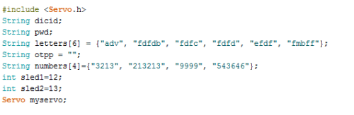
Smart Wireless Locking System – Coding
First, we need to include the library and declare the variables needed, as in a snippet of code. We include a servo library, then create a string array to generate a password. After this, we need to create a few more string variables to store password, OTP, and LED pin numbers as in snippet of the code.
1. Arduino Code.

Slide 4
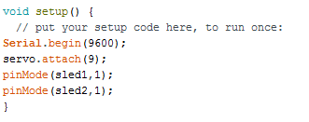
In the second part of coding, we need to set up serial and Braud rates for Bluetooth. Here I have used the 9600 Braud rate but if it didn’t work, you can use the default Braud rate of Hc 05 i.e. (38400). Then, we have to set up a pin for the servo using servo.attach (PWM pin number). After that, we can define pin mode as output for led refer.
2. Setting I/O and Bluetooth

Slide 5
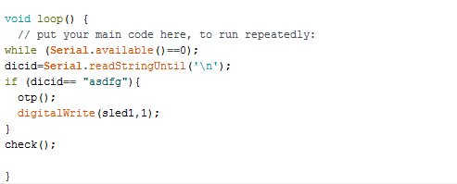
In the third part of the code, we will create a loop and check the data coming from Bluetooth. Then we create an if() statement to check the device id. If it matches, then it calls otp() function for the generation of OTP.
3. Arduino code checking device Id

Slide 6
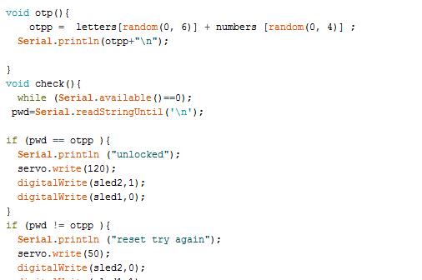
Then we need to create a check() function to check whether OTP is correct or not. If it is correct then it turns the servo to an open position.
4. Arduino code for checking OTP

Slide 7
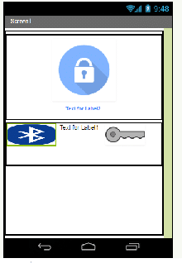
APP Building
First, we need to create a layout as in the pic. Just drag and drop or download the .aia file for it from the link below.
Layout of App in MIT app inventor

Slide 8
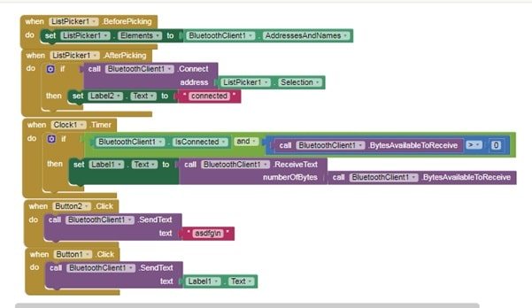
Now let’s get into the code Blocks tab, for coding.
First, we need to initialize the Bluetooth list available for connection. Then we have to set the button function to send the device id according to our Arduino Code as in the pic below.
MIT app inventor coding blocks
Now, export the app .apk and install it on your Android phone.
You can get .apk, .aia file, and code from the link below.

Slide 9
Connecting Components:
Arduino Pins | Components and Pin
Arduino Pin 9(pwm) | Servo Yellow Wire (signal input wire)
Rx | Bluetooth Module TX
Tx | Bluetooth Module RX
GND | GND Bluetooth
VCC | Bluetooth VCC
Pin 12 | LED
GND | Battery(-VE)

Slide 10
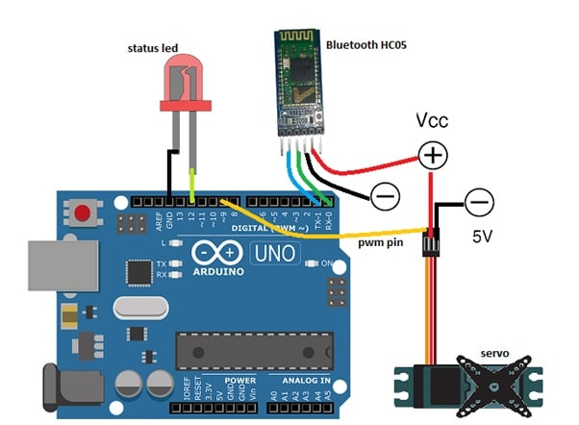
The whole circuit and connections are illustrated in the pic below
We have connected all the components now. You might not like to fry a costly Arduino board with the wrong connection. So, always crosscheck your setup to ensure that all connections are ok.

Slide 11
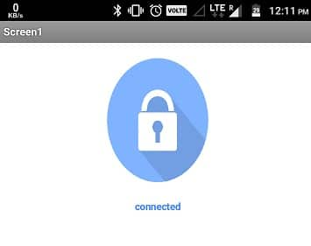
Testing
First, connect the Arduino and components to a power supply. Here I have used 5V Power Bank for it. Next, open the installed App, then turn on the Bluetooth of the phone. When you tap on the Bluetooth icon, you will get the list of Bluetooth connections for pairing. Now, tap on HC 05. On successful pairing, you will get a ‘connected’ message on the App.

Slide 12
After that, tap on the key icon to send the device id to match. If the device id is matched, it will send an OTP to your app that you can see in the App text bar between Bluetooth and the lock icon.
Now, you can tap on the lock icon to unlock your Smart Lock. If everything is ok then the servo moves the unlocking mechanism and the onboard LED of Arduino lights up indicating successful unlock. I have used servo because of its high torque, and also because we can control the angle of its movement which helps in the unlocking mechanism of the lock.
Thank you

